Slide 1
KYNDRYL Shared Infra CH
Azure Landing Zone – Security
Wojciech Pazdzierkiewicz – Infrastructure Architect
4.05.2022

Slide 2

00
Welcome
Architecture of IdM solutions (AD DS, AD FS, AD CS, AAD)
Private, hybrid and public cloud projects
Authorized Microsoft Trainings
Wojciech Pazdzierkiewicz | LinkedIn

Slide 3
Agenda
01 Principles and requirements
02 Governance
03 Regulatory compliance
04 Host security
05 Storage security
06 Network security
07 Application security
08 Identity and access security
09 Proposal
10 Issues and challenges

Slide 4
01
Principles and requirements
Principles
Least privilege (just enough access – just in time)
Data encryption at rest and in transit
Endpoint protection
Monitor system security
Cross-border constrains including access to resources outside of Switzerland
Zero Trust approach
Standards
ABB-SEC-001 Audit & Regulatory Servcies
ABB-SEC-002 Emergency Response Servcies
ABB-SEC-003 Endpoint Security
ABB-SEC-004 Vulnerability Scanning
ABB-SEC-005 Health Checks
ABB-SEC-006 SIEM
ABB-SEC-007 Identity & Authorization Management
Functional requirements
Adaptive isolation in the following areas:
computing platform
storage
networking
log collection
analytics
monitoring / alerting
IAM
Non-functional requirements
Must comply with security features of the design and support FINMA audits

Slide 5
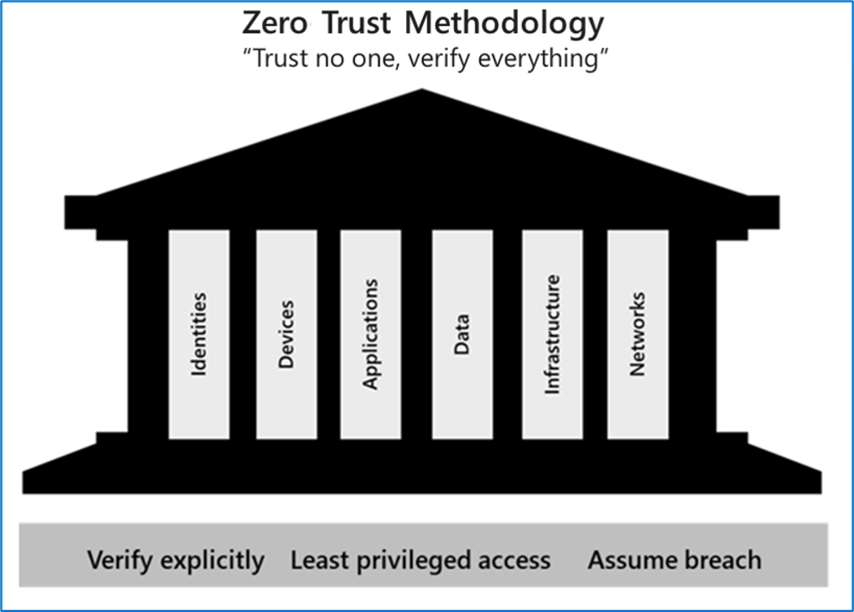
01
Principles and requirements
Zero Trust assumes everything is on an untrusted network, including resources behind the firewalls of the corporate network. Main principle: “trust no one, verify everything.”
In practice:
we no longer assume that a password is sufficient to validate a user but add multi-factor authentication to provide additional checks
instead of granting access to all devices on the corporate network, users are allowed access only to the specific applications or data that they need
Microsoft Zero Trust Guidance Center | Microsoft Docs
Core Principle of Zero Trust
The network is considered hostile (assume breach)
Access control enforcement is as granular as possible (least privilege/ identity perimeter)
User privileges and attributes granting access to resources are continuously monitored and validated (always monitor and verify/never trust)

Slide 6
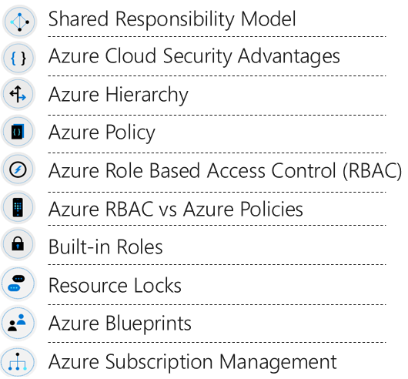
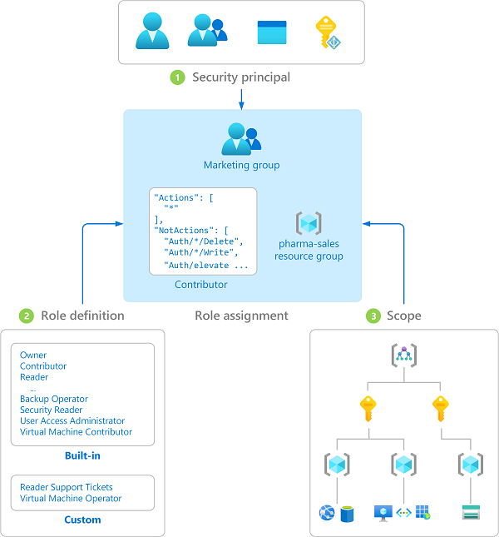
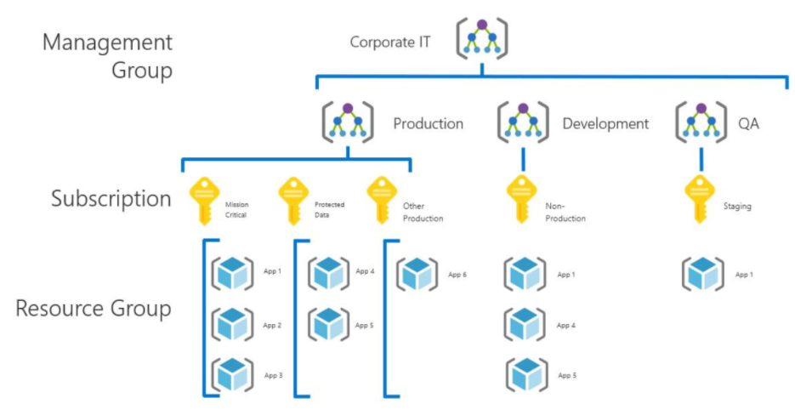
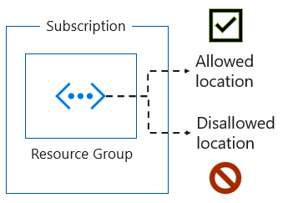
02
Governance
Azure Security Benchmark v3 - Governance and Strategy | Microsoft Docs

Slide 7
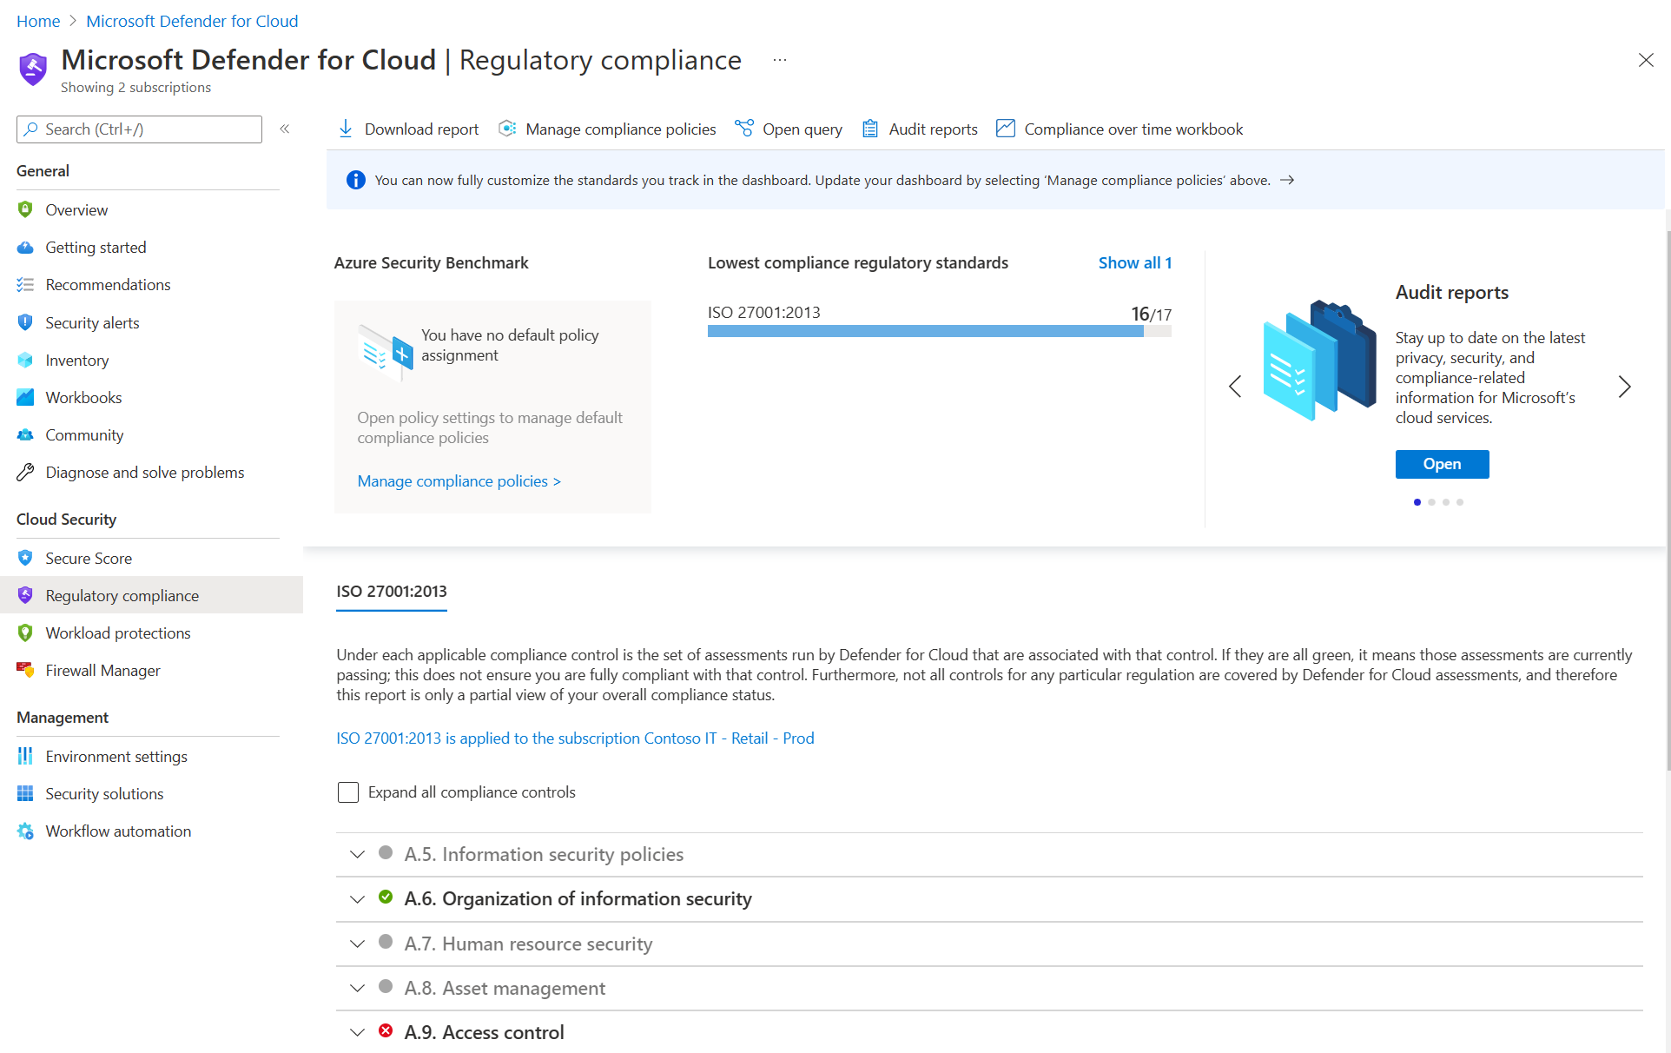
03
Regulatory compliance
Microsoft Defender for Cloud for regulatory compliance
The Azure Security Benchmark (ASB) provides prescriptive best practices and recommendations to help improve the security of workloads, data, and services on Azure
Security controls: These recommendations are generally applicable across your Azure tenant and Azure services. Each recommendation identifies a list of stakeholders that are typically involved in planning, approval, or implementation of the benchmark.
Service baselines: These apply the controls to individual Azure services to provide recommendations on that service’s security configuration.
Overview of the Azure Security Benchmark v3 | Microsoft Docs

Slide 8
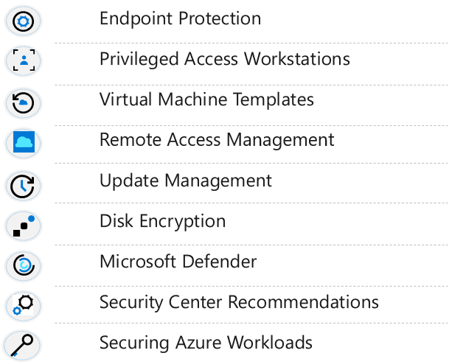
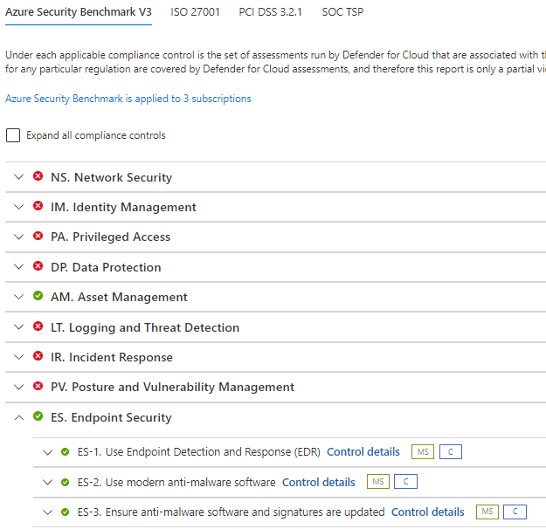
04
Host security

Slide 9
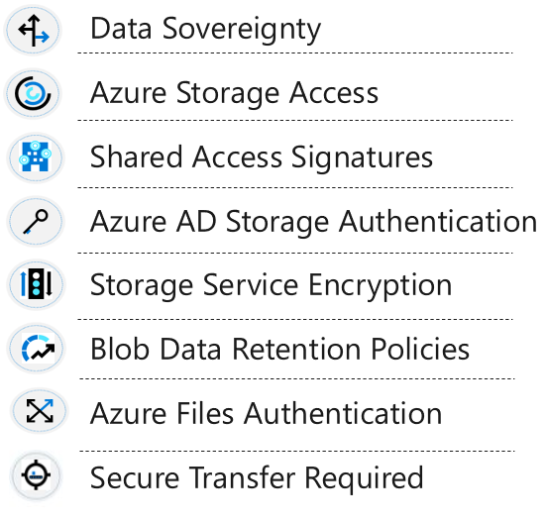
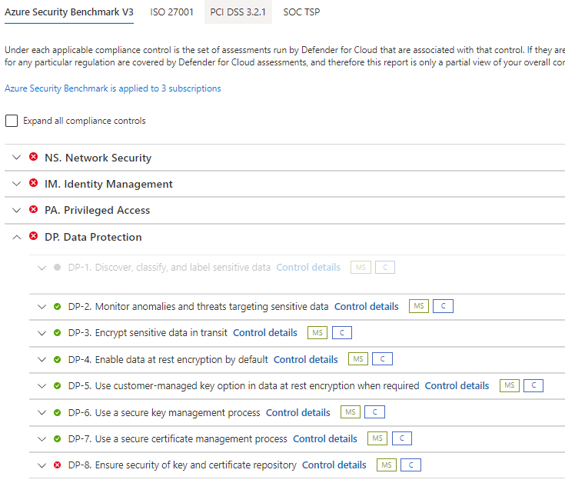
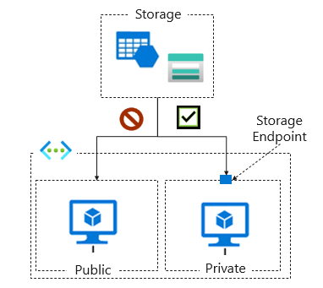
05
Storage security

Slide 10
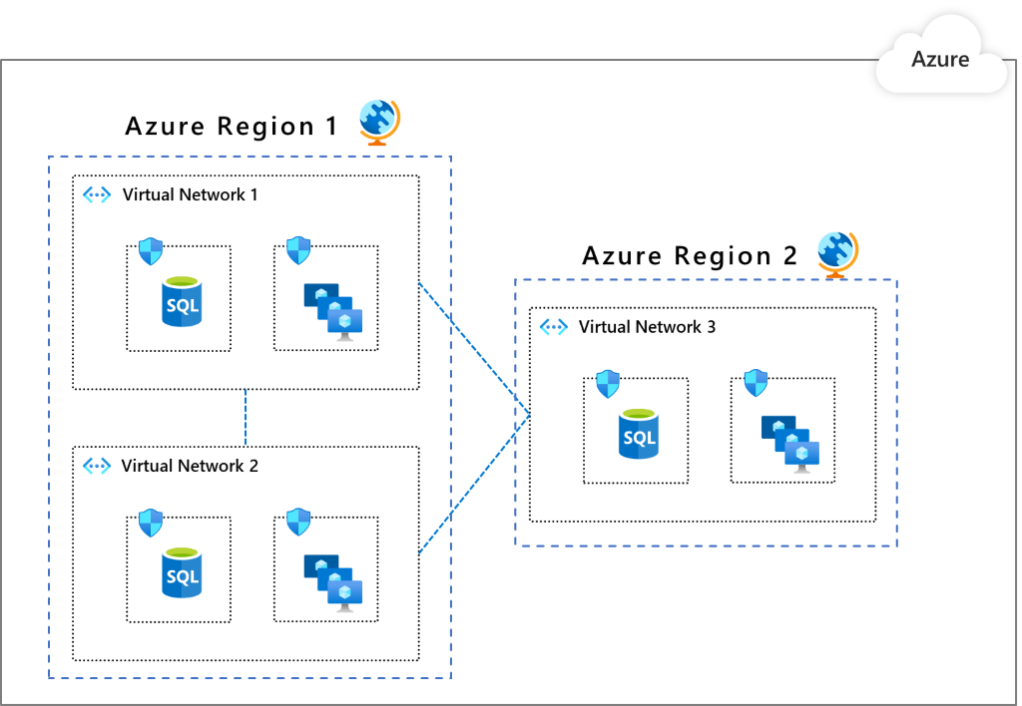
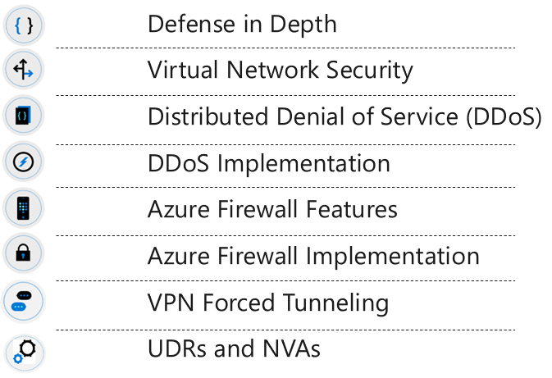
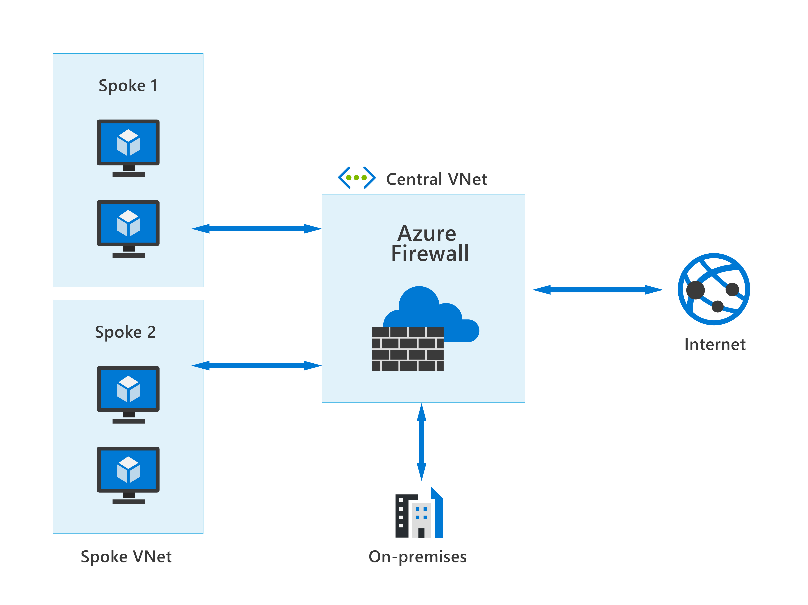
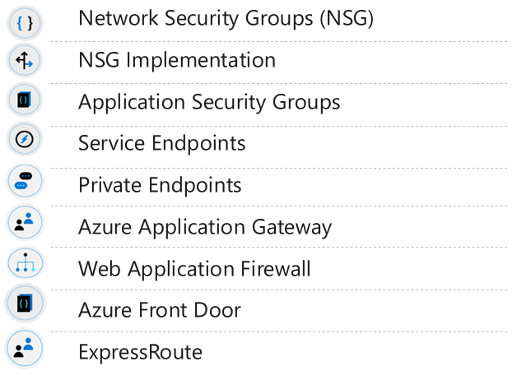
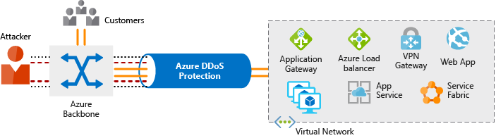
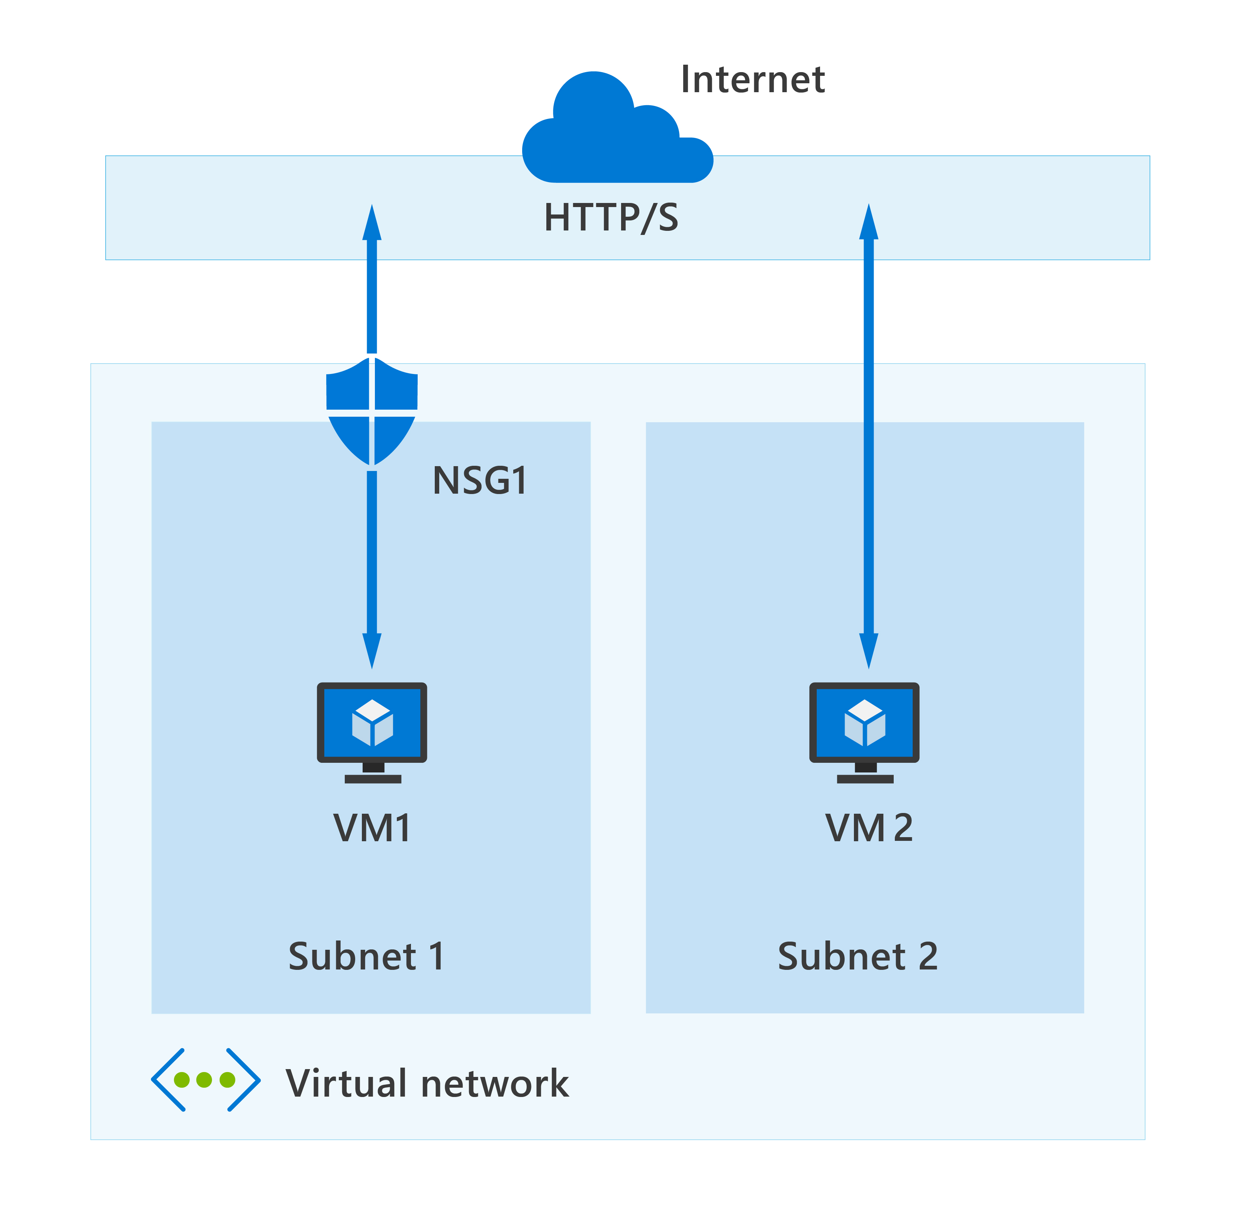

06
Network security

Slide 11
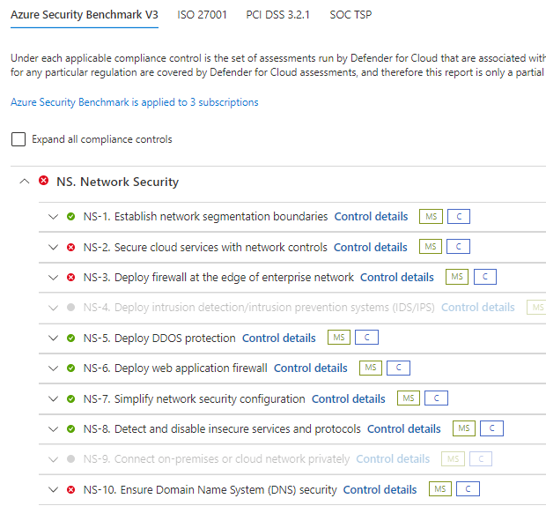
06
Network security
Azure Security Benchmark v3 - Network Security | Microsoft Docs

Slide 12
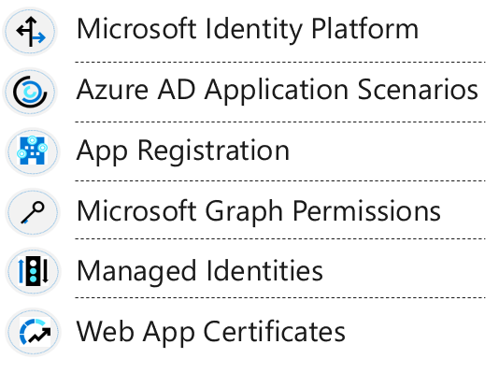
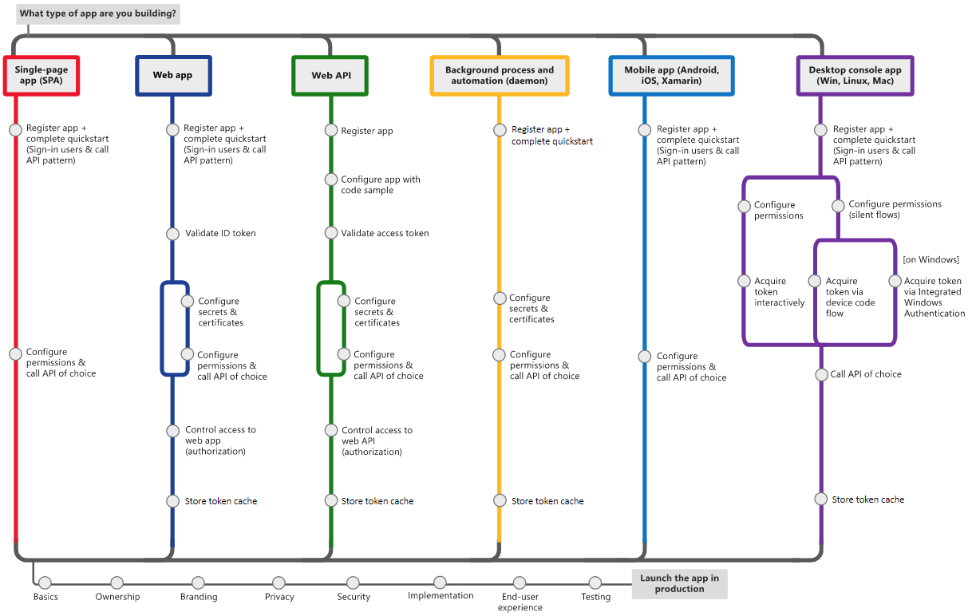
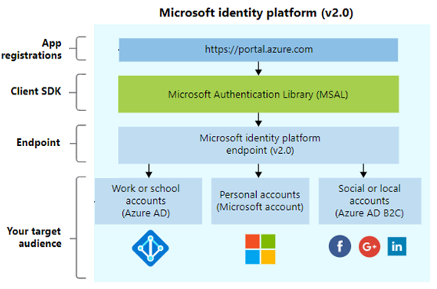
07
Application security

Slide 13
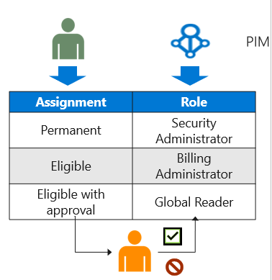
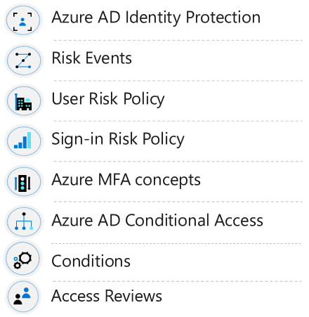
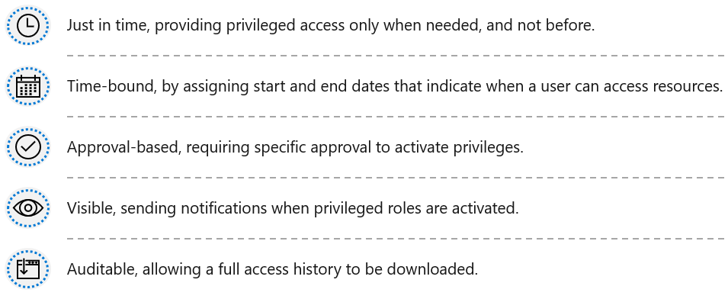
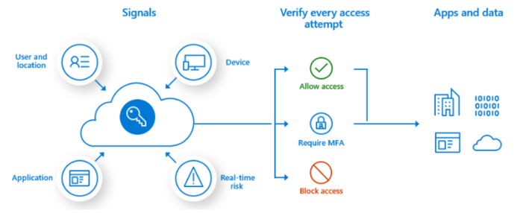
08
Identity and access security
Zero Trust: Always Verify – Least Access Principle – Assume Breach

Slide 14
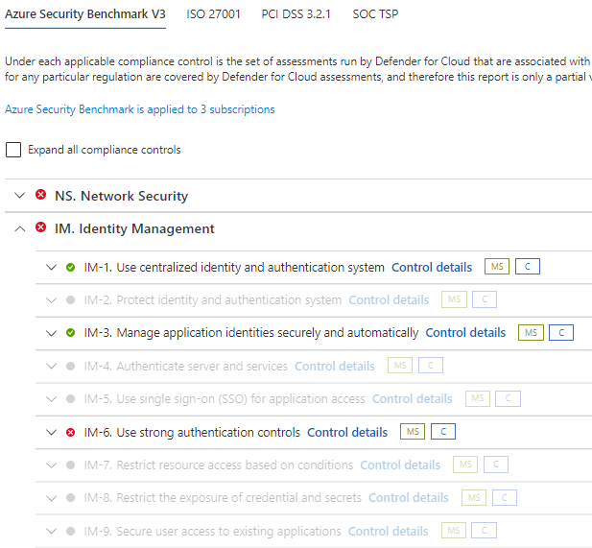
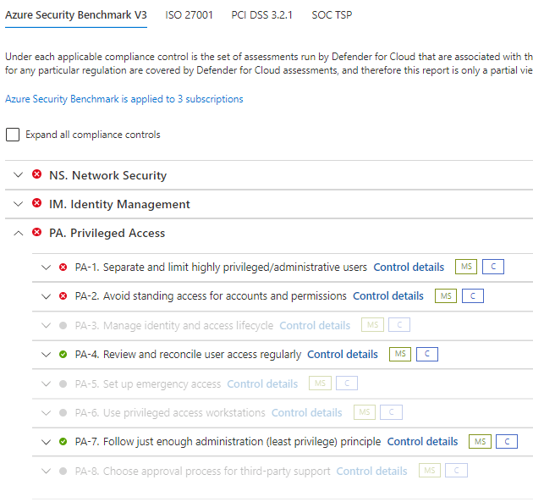
08
Identity and access security

Slide 15
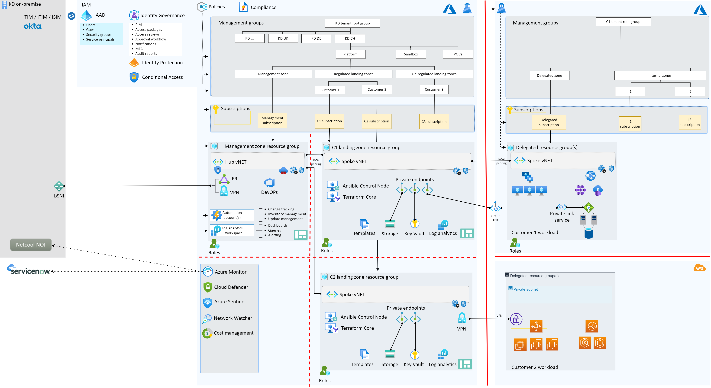
09
Proposal

Slide 16
10
Issues and challenges
Challenges / issues:
Isolation of Sentinel and any other global available service
Delegation model in Azure Lighthouse (bank vs. proxy like solutions)
Dependencies:
Policy/resource templates FINMA ready

Slide 17
THANK YOU

